Slide 1
Information Retrieval with Long Legal Documents
By Michel Custeau
Supervised by Diana Inkpen

Slide 2
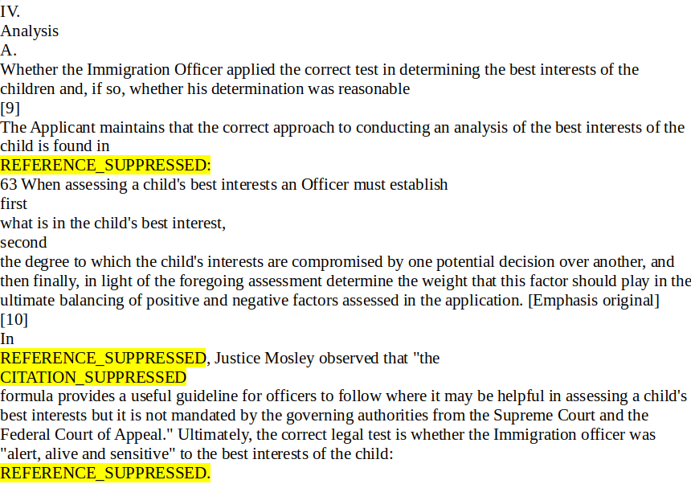
What is Information Retrieval?

Slide 3

How do you measure relevance?

Slide 4
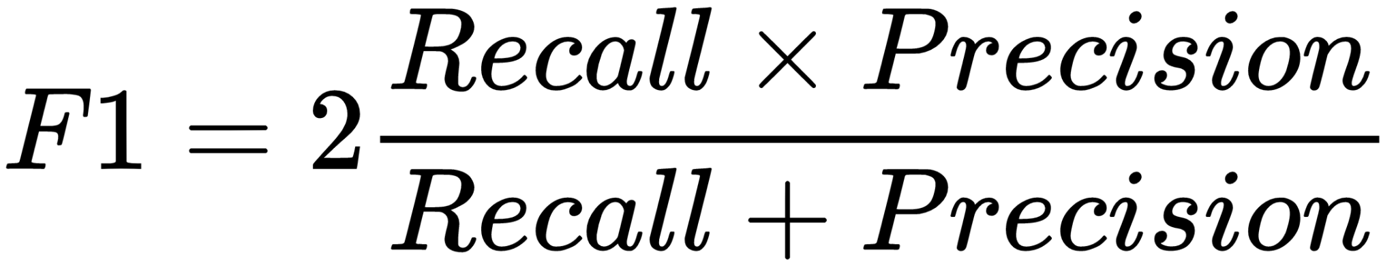
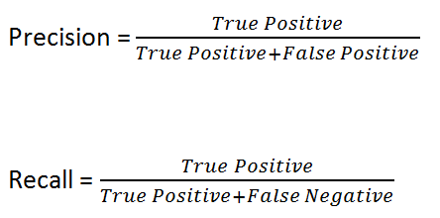
How do you measure relevance?

Slide 5
Datasets
dataset | COLIEE-2021 test set | FIRE-2017-IRLeD
Number of query cases | 250 | 200
Number of documents | 900 | 2000

Slide 6
Strategy 1: look at entire document

Slide 7
Results at top 10 documents
datasets | Canadian Legal Documents | Indian Legal Documents
Recall | 0.3889 | 0.3290
Precision | 0.1400 | 0.1645
F1 | 0.2059 | 0.2193

Slide 8
Strategy 2: Target word around the spots where a reference was removed

Slide 9
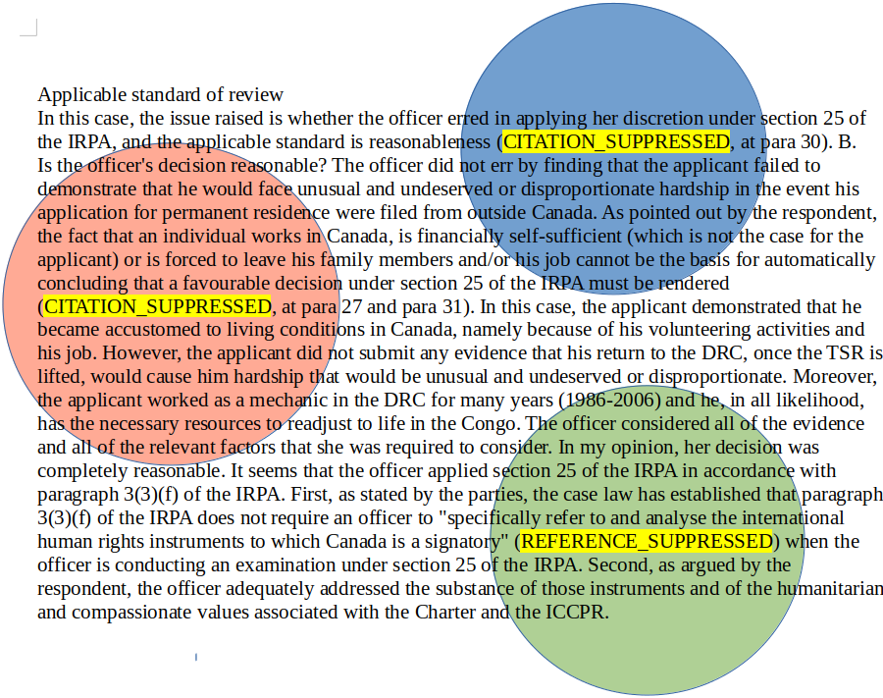

Slide 10
q = [ q₁ , q₂ , q₃ ]

Slide 11
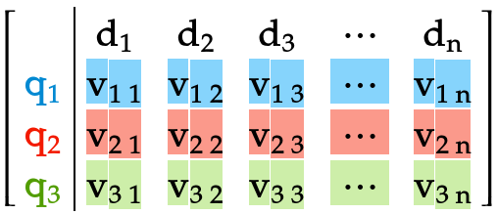
q = [ q₁ , q₂ , q₃ ]
Score( q , documents ) =

Slide 12

Ranked_docs = [doc 1 , doc 2, … , doc n]

Slide 13
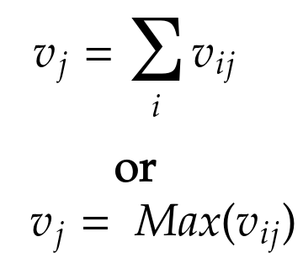
Ranked_docs = [doc 1 , doc 2, … , doc n]

Slide 14
Results
Canadian legal documents | Indian Legal Documents
Scoring function | Sum | Max | Sum | Max
Recall | 0.4222 | 0.3967 | 0.411 | 0.4790
Precision | 0.1520 | 0.1475 | 0.2050 | 0.2395
F1 | 0.2235 | 0.2102 | 0.2740 | 0.3196
Number of words per fragment: 128

Slide 15
Previous F1 scores:
COLIEE2021: 0.2059
FIRE-2017-IRLeD: 0.2193
New F1 scores:
COLIEE2021: 0.2235
FIRE-2017-IRLeD: 0.3196
Number of words per fragment: 128

Slide 16
Strategy 3: take advantage of document structure

Slide 17
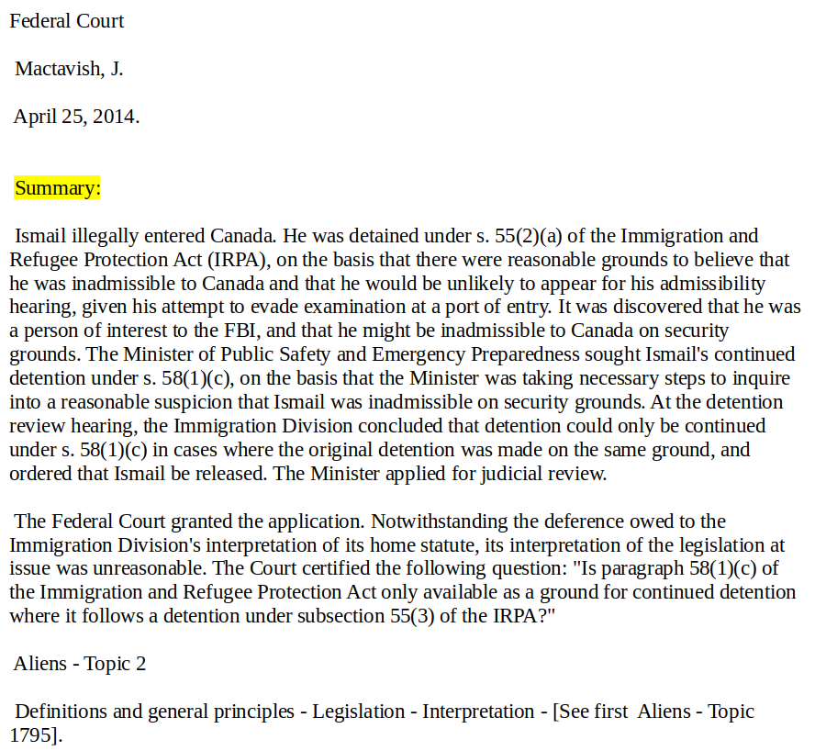
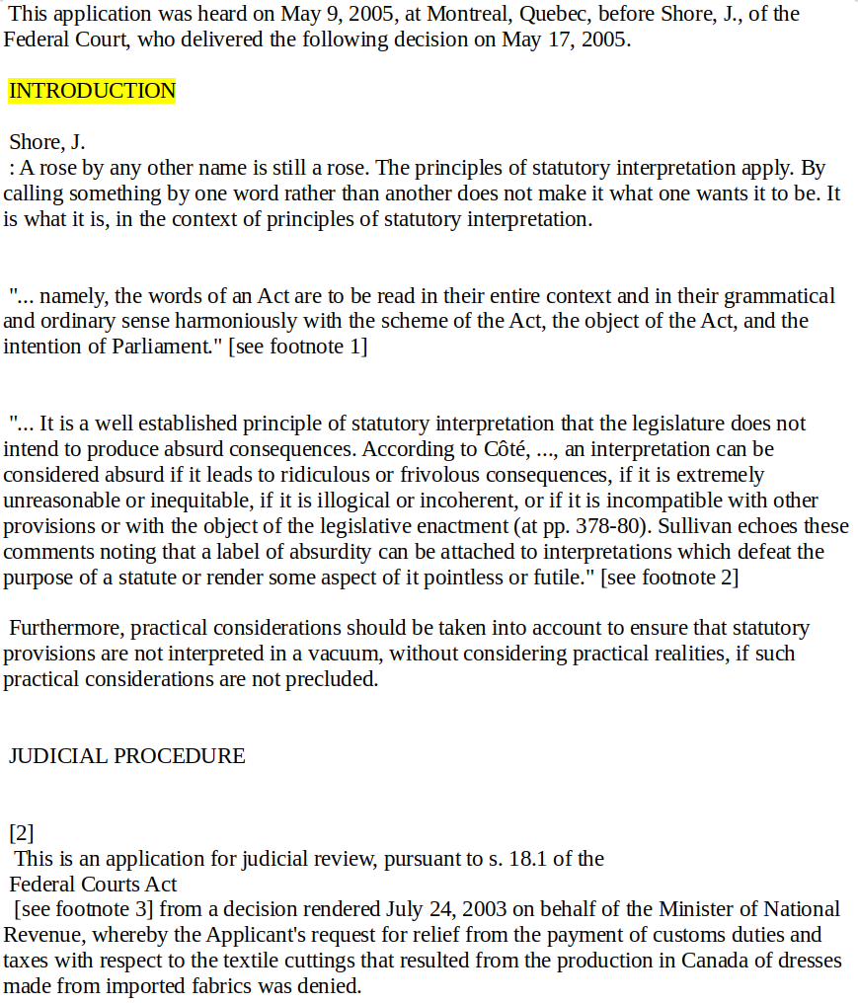

Slide 18
Results for Canadian legal documents
Recall | 0.4187
Precision | 0.1508
F1 | 0.2218
Number of words for each query and doc: 512

Slide 19
F1 score from initial strategy:
COLIEE2021: 0.2059
F1 score from second strategy:
COLIEE2021: 0.2235
New F1 score:
COLIEE2021: 0.2218

Slide 20
Strategy 4: Using Bert alongside BM25+

Slide 21
Results
datasets | Canadian Legal Documents | Indian Legal Documents
Recall | 0.2078 | 0.1300
Precision | 0.0748 | 0.0650
F1 | 0.1100 | 0.0867
Number of words per fragment: 128

Slide 22
Best F1 score achieved using BM25:
COLIEE2021: 0.2235
FIRE-2017-IRLeD: 0.3196
F1 score using Bert:
COLIEE2021: 0.1100
FIRE-2017-IRLeD: 0.0867

Slide 23
Comparing results to COLIEE2021 task 1 competition winners

Slide 24
Competition dataset
queries | Candidate documents
Same as test set: 250 | Train queries + train documents + test queries + test documents: 4415

Slide 25
Competition Results
F1 score of winning team using Linear Interpolation model: 0.1917
My F1 score using BM25+: 0.1532

Slide 26
Questions?

